Slide 1
DR. D. Y. PATIL SCHOOL OF SCIENCE & TECHNOLOGY, TATHAWADE, PUNE.
A MINI-PROJECT
ON
Customer Segmentation for a Mall using Multivariate Analysis
Guided By: Ms. Gayatri Bhise
Bachelor Of Computer Science Academic
Year :2024-25
Ms Tanaya Shinde
Ms Saniya Mulla
Ms Shravani Patki

Slide 2

Customer Segmentation for a Mall using Multivariate Analysis
Tanaya s

Slide 3
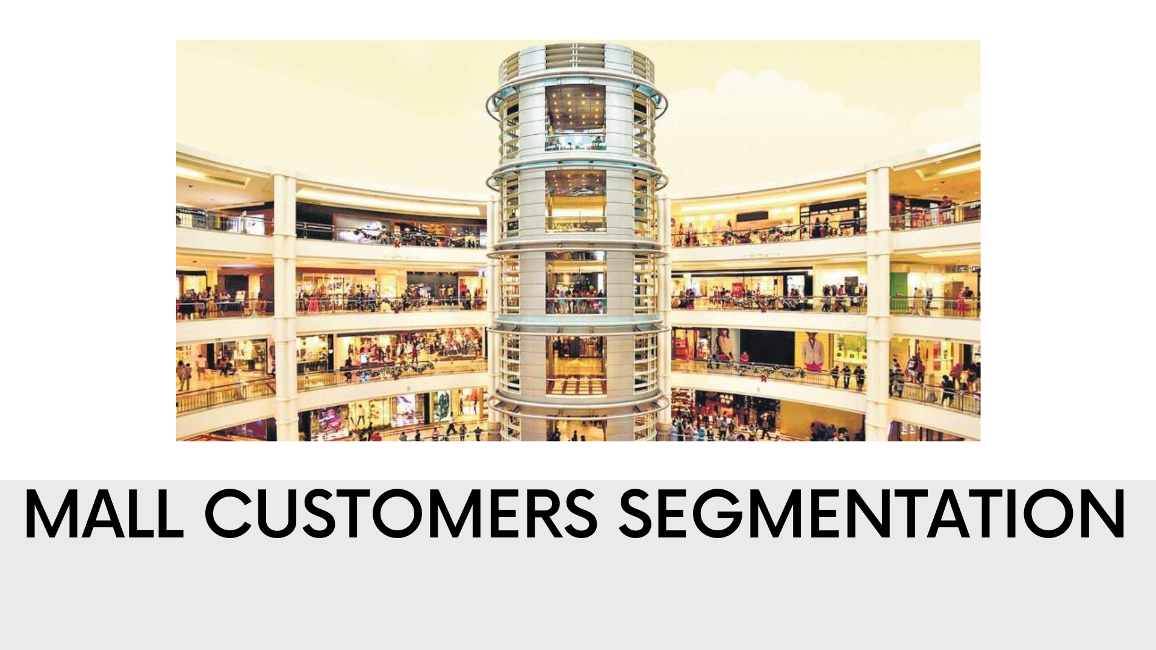
Problem Statement
Mall management aims to improve marketing effectiveness, enhance customer experience, and increase overall sales by better understanding the diverse characteristics of its customers. However, the current marketing strategies target customers uniformly without considering differences in purchasing behavior, spending capacity, age groups, and income levels. This results in inefficient allocation of promotional resources and missed opportunities for personalized engagement.

Slide 4
PURPOSE
Identify distinct customer groups based on multiple attributes simultaneously.
Optimize tenant mix (fashion, electronics, food, entertainment) to match customer clusters.
Personalize marketing campaigns for higher engagement and conversion.
Improve customer experience by tailoring events, loyalty programs, and services.
Maximize profitability by focusing on high-value segments while retaining diverse visitors.

Slide 5
GOALS
Deliver personalized experiences to different customer types.
Align tenant mix and services with customer demand.
Increase footfall, sales, and customer loyalty.
Enhance marketing efficiency by targeting the right audience with the right message.

Slide 6
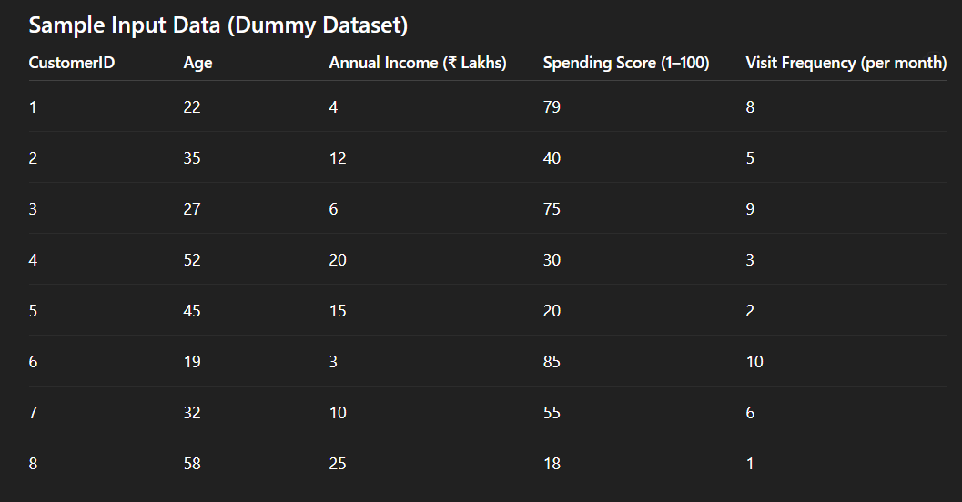
Example:
Output:
Cluster 1: Young High-Spenders
Age: 18–30
High spending, frequent visits
Likes fashion, food, entertainment
Cluster 2: Moderate Middle-Aged Shoppers
Age: 30–40
Medium income & spending
Visit mall regularly
Prefer electronics, home goods
Cluster 3: High-Income Low-Spenders
Age: 45–60
High income, low spending
Rare visitors
Prefer premium & luxury stores

Slide 7
THE PROTOTYPE
Use sample data from mall customers.
Create 3–5 clusters (similar customer groups).
Show results using charts, tables, persona cards.
Test and refine the model.
Apply it to improve marketing, loyalty programs, tenant mix.

Slide 8

Conclusion
Multivariate segmentation gives deep insights.
Helps mall increase profit, retention & satisfaction.
Supports marketing & loyalty strategies.
Data privacy and changing behavior are major challenges.
Overall, it is a powerful tool for mall growth

